Slide 1

Personal Key Indicators of Heart Disease
DBDA.X404.(34) Data Analysis Introduction
UCSC Extension Program- Data Science
by Sena KAYA

Slide 2
The importance of the dataset
According to the CDC, heart disease is one of the leading causes of death for people of most races in the US.
Originally, the dataset come from the CDC and is a major part of the Behavioral Risk Factor Surveillance System (BRFSS), which conducts annual telephone surveys to gather data on the health status of U.S. residents.
The dataset contains 18 variables (9 booleans, 5 strings and 4 decimals).
by Kaggle

Slide 3
Details about the dataset
> #dimension of dataset
> dim(heartd)
[1] 319795 18
> sum(is.na(heartd))
[1] 0
> #table of HeartDisease
> table(heartd$HeartDisease)
No Yes
292422 27373
> #the number of different values for each column
heartd %>% summarise_all(n_distinct)
HeartDisease BMI Smoking AlcoholDrinking Stroke PhysicalHealth MentalHealth
2 3604 2 2 2 31 31
DiffWalkingSexAgeCategoryRaceDiabeticPhysicalActivityGenHealthSleepTimeAsthma
2 2 13 6 4 2 5 24 2
KidneyDisease SkinCancer
2 2
#a list of objects and their structure
str(heartd)
'data.frame': 319795 obs. of 18 variables:
$ HeartDisease : chr "0" "0" "0" "0" ...
$ BMI : num 16.6 20.3 26.6 24.2 23.7 ...
$ Smoking : chr "1" "0" "1" "0" ...
$ AlcoholDrinking : chr "0" "0" "0" "0" ...
$ Stroke : chr "0" "1" "0" "0" ...
$ PhysicalHealth : num 3 0 20 0 28 6 15 5 0 0 ...
$ MentalHealth : num 30 0 30 0 0 0 0 0 0 0 ...
$ DiffWalking : chr "0" "0" "0" "0" ...
$ Sex : chr "0" "0" "1" "0" ...
$ AgeCategory : chr "55" "80" "65" "75" ...
$ Race : chr "White" "White" "White" "White" ...
$ Diabetic : num 1 0 1 0 0 0 0 1 0 0 ...
$ PhysicalActivity: chr "1" "1" "1" "0" ...
$ GenHealth : chr "4" "4" "2" "3" ...
$ SleepTime : num 5 7 8 6 8 12 4 9 5 10 ...
$ Asthma : chr "1" "0" "1" "0" ...
$ KidneyDisease : chr "0" "0" "0" "0" ...
$ SkinCancer : chr "1" "0" "0" "1" ...

Slide 4
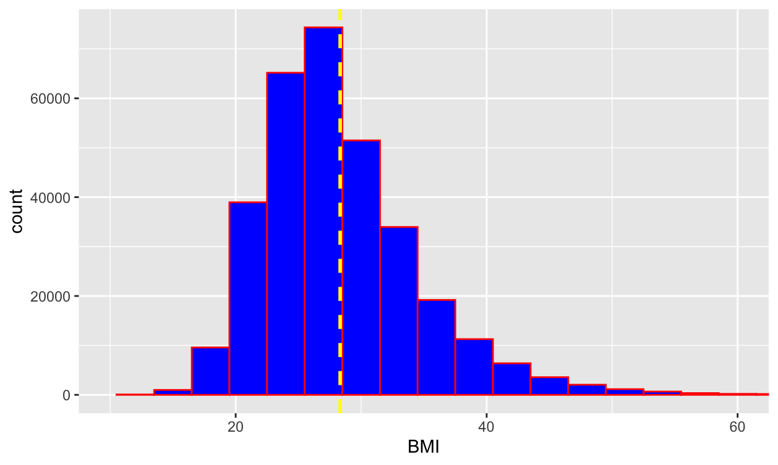
EDA (EXPLORATORY DATA ANALYSIS)
#histogram of BMI(Body Mass Index)
p<-ggplot(data = heartd, aes(x = BMI)) + geom_histogram(binwidth = 3,fill='blue',colour="red")+ coord_cartesian(xlim = c(10, 60))
p+ geom_vline(aes(xintercept=mean(BMI)), color="yellow", linetype="dashed", size=1)

Slide 5
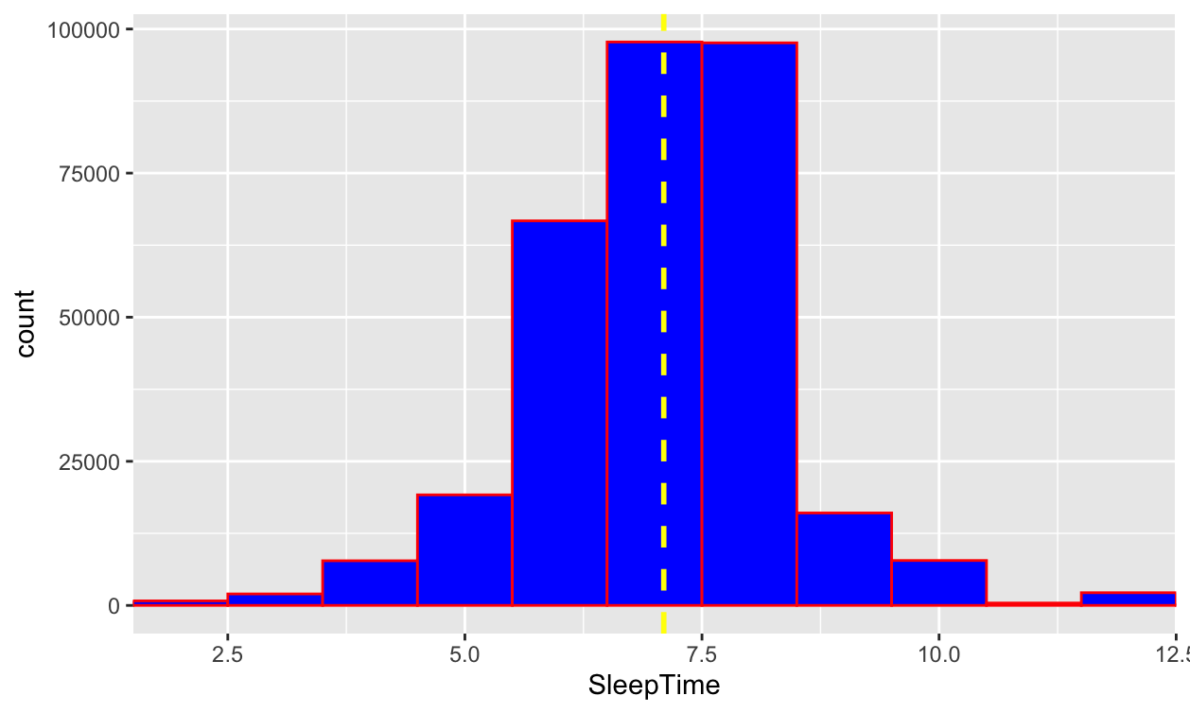
EDA (EXPLORATORY DATA ANALYSIS)
#histogram of Sleep Time
p<-ggplot(data = heartd, aes(x = SleepTime)) + geom_histogram(binwidth = 1,fill='blue',colour="red")+ coord_cartesian(xlim = c(2, 12))
p+ geom_vline(aes(xintercept=mean(SleepTime)), color="yellow", linetype="dashed", size=1)

Slide 6
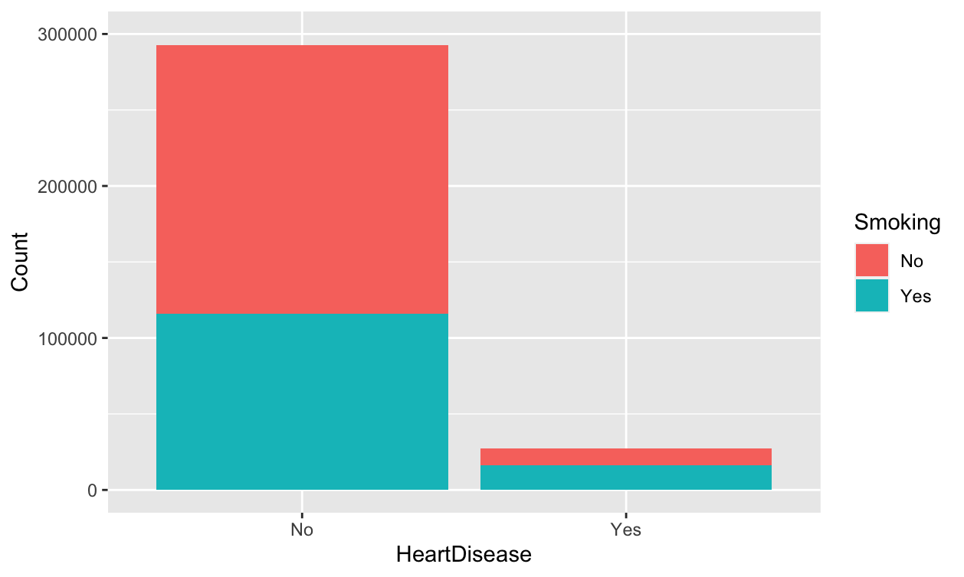
Stacked Bar Plot of Heart Disease and Smoking
# Create the stacked bar plot for two categorical variable heartdisease and smoking
ggplot(heartd, aes(x = HeartDisease, fill = Smoking)) +
geom_bar() +
xlab("HeartDisease") +
ylab("Count") +
coord_cartesian(ylim = c(0, 300000))
ggtitle("Bar Plot of HeartDisease and Smoking")

Slide 7
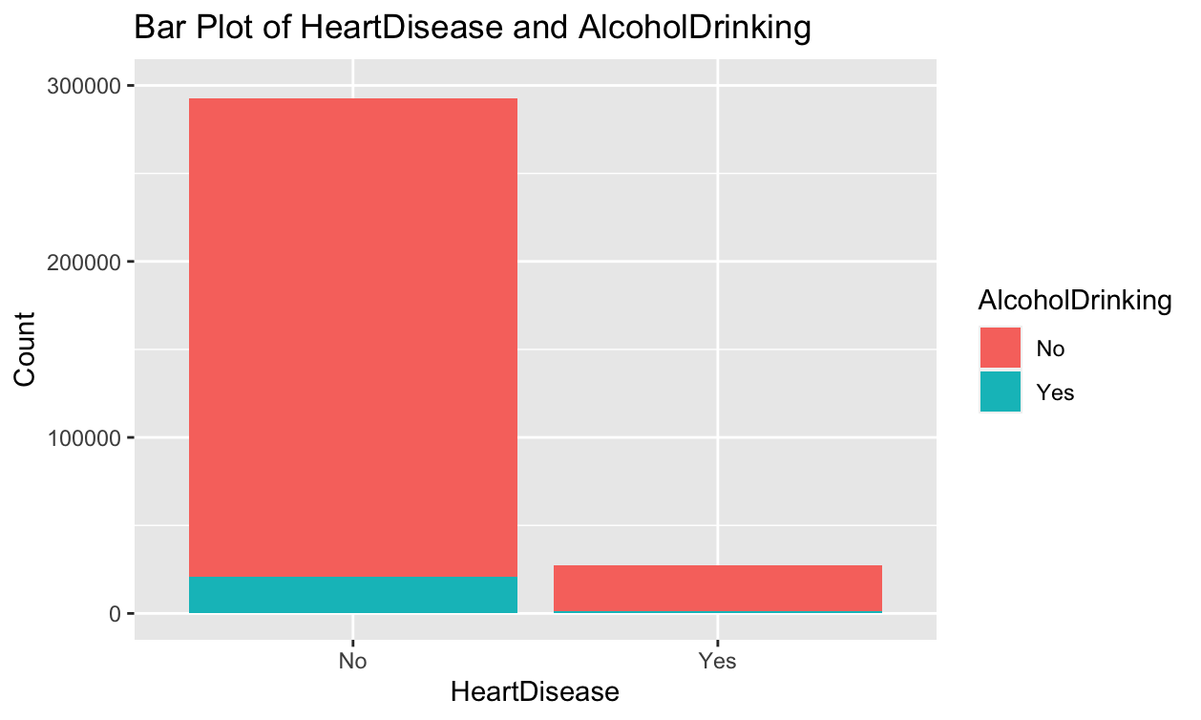
Stacked Bar Plot of Heart Disease and Alcohol Drinking
# Create the stacked bar plot for two categorical variable heartdisease and smoking
ggplot(heartd, aes(x = HeartDisease, fill = AlcoholDrinking)) +
geom_bar() +
xlab("HeartDisease") +
ylab("Count") +
coord_cartesian(ylim = c(0, 300000))+
ggtitle("Bar Plot of HeartDisease and AlcoholDrinking")

Slide 8
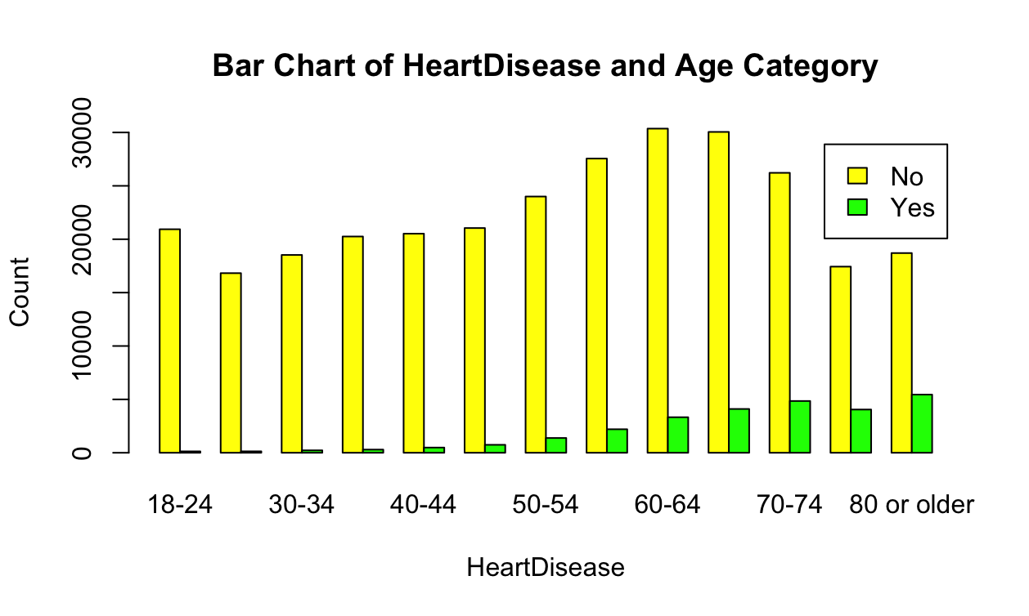
Bar Chart of Heart Disease and Age Category
# Count the frequencies of each combination of the two variables
counts <- table(heartd$HeartDisease, heartd$AgeCategory)
# Define colors for the bars
colors <- c("yellow", "green")
# Create the bar chart
barplot(counts, beside = TRUE, legend = TRUE,
xlab = "HeartDisease", ylab = "Count",
main = "Bar Chart of HeartDisease and Age Category", col = colors)

Slide 9
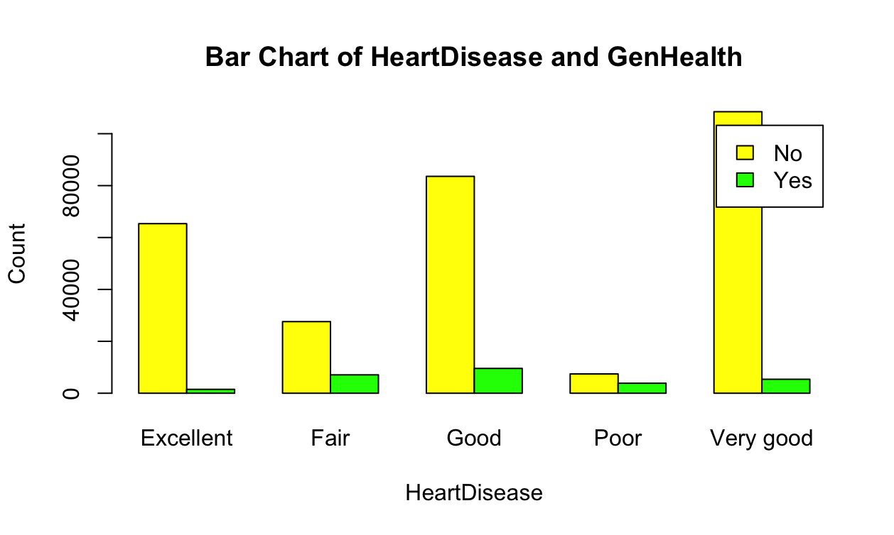
Bar Chart of Heart Disease and General Health
# Count the frequencies of each combination of the two variables
counts <- table(heartd$HeartDisease, heartd$GenHealth)
# Define colors for the bars
colors <- c("yellow", "green")
# Create the bar chart
barplot(counts, beside = TRUE, legend = TRUE,
xlab = "HeartDisease", ylab = "Count",
main = "Bar Chart of HeartDisease and GenHealth", col = colors)

Slide 10
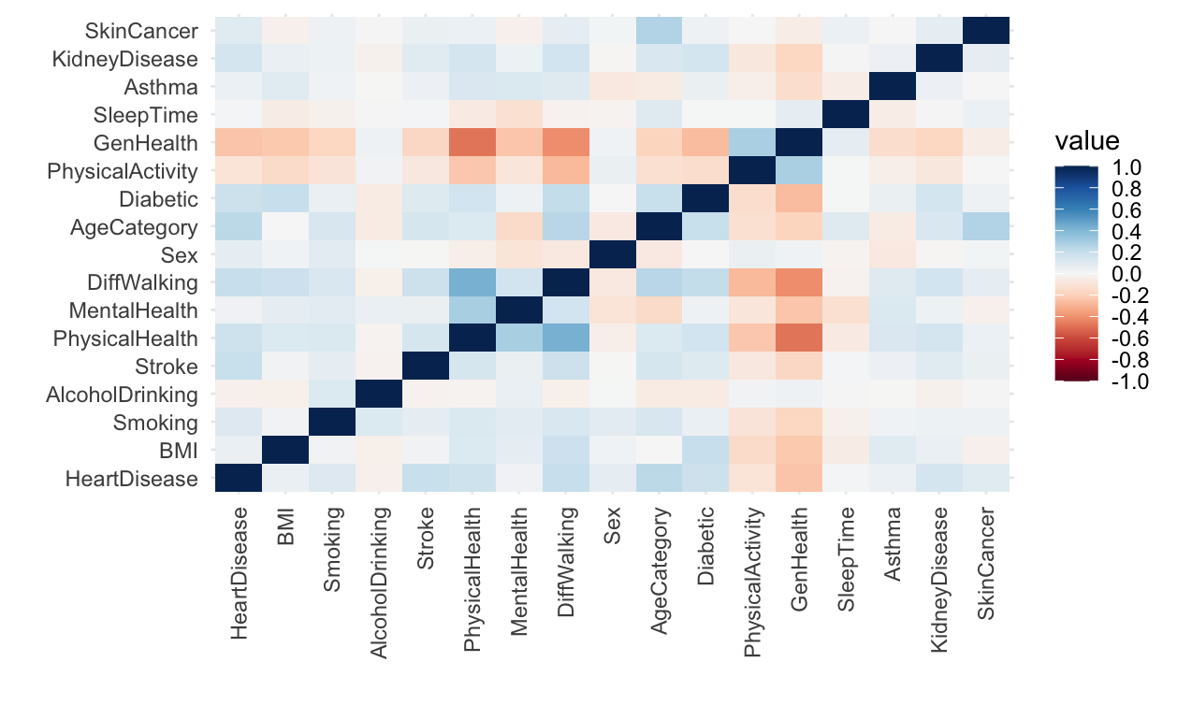
Corrolation Matrix No correlations above 0.75 found.

Slide 11
ONE-HOT ENCODING
# Perform one-hot encoding for the "Race" column
df_encoded <- heartd
# Extract the "Race" column
race_column <- df_encoded$Race
# Perform one-hot encoding for the "Race" column
encoded_cols <- model.matrix(~ 0 + factor(race_column))
colnames(encoded_cols) <- paste("Race", colnames(encoded_cols), sep = "_")
# Add the encoded columns to the data set
df_encoded <- cbind(df_encoded, encoded_cols)
# Remove the original "Race" column
df_encoded <- df_encoded[, !names(df_encoded) %in% "Race"]
# Print the encoded data set
print(df_encoded)
str(df_encoded)
> str(df_encoded)
'data.frame': 319795 obs. of 23 variables:
…..
$ $ Race_factor(race_column)American Indian/Alaskan Native: num 0 0 0 0 0 0 0 0 0 0 ...
$ Race_factor(race_column)Asian : num 0 0 0 0 0 0 0 0 0 0 ...
$ Race_factor(race_column)Black : num 0 0 0 0 0 1 0 0 0 0 ...
$ Race_factor(race_column)Hispanic : num 0 0 0 0 0 0 0 0 0 0 ...
$ Race_factor(race_column)Other : num 0 0 0 0 0 0 0 0 0 0 ...
$ Race_factor(race_column)White : num 1 1 1 1 1 0 1 1 1 1 ...

Slide 12
SCALING
# Scale the numeric variables
# Apply min-max scaling to the numerical variables
scaled_data <- apply(df_encoded[, numeric_vars], 2, function(x) (x - min(x)) / (max(x) - min(x)))
# Print the scaled data
print(scaled_data)
# Combine the scaled numeric variables with the non-numeric variables
scaled_dataframe <- cbind(scaled_data, df_encoded[!numeric_vars])
str(scaled_dataframe)
# Print the scaled data frame
print(scaled_dataframe)
mean(scaled_dataframe$BMI)
sd(scaled_dataframe$BMI)
> mean(scaled_dataframe$BMI)
[1] 0.1968538
> sd(scaled_dataframe$BMI)
[1] 0.07673669

Slide 13
scaled_dataframe
> str(scaled_dataframe)
'data.frame': 319795 obs. of 23 variables:
$ BMI : num 0.0553 0.1004 0.1758 0.1472 0.1411 ...
$ Smoking : num 1 0 1 0 0 1 0 1 0 0 ...
$ AlcoholDrinking : num 0 0 0 0 0 0 0 0 0 0 ...
$ Stroke : num 0 1 0 0 0 0 0 0 0 0 ...
$ PhysicalHealth : num 0.1 0 0.667 0 0.933 ...
$ MentalHealth : num 1 0 1 0 0 0 0 0 0 0 ...
$ DiffWalking : num 0 0 0 0 1 1 0 1 0 1 ...
$ Sex : num 0 0 1 0 0 0 0 0 0 1 ...
$ AgeCategor : num 0.597 1 0.758 0.919 0.355 ...
$ Diabetic : num 1 0 1 0 0 0 0 1 0 0 ...
$ PhysicalActivity : num 1 1 1 0 1 0 1 0 0 1 ...
$ GenHealth : num 0.75 0.75 0.25 0.5 0.75 0.25 0.25 0.5 0.25 0.5 ...
$ SleepTime : num 0.174 0.261 0.304 0.217 0.304 ...
$ Asthma : num 1 0 1 0 0 0 1 1 0 0 ...
$ KidneyDisease : num 0 0 0 0 0 0 0 0 1 0 ...
$ SkinCancer : num 1 0 0 1 0 0 1 0 0 0 ...
$ Race_factor(race_column)American Indian/Alaskan Native: num 0 0 0 0 0 0 0 0 0 0 ...
$ Race_factor(race_column)Asian : num 0 0 0 0 0 0 0 0 0 0 ...
$ Race_factor(race_column)Black : num 0 0 0 0 0 1 0 0 0 0 ...
$ Race_factor(race_column)Hispanic : num 0 0 0 0 0 0 0 0 0 0 ...
$ Race_factor(race_column)Other : num 0 0 0 0 0 0 0 0 0 0 ...
$ Race_factor(race_column)White : num 1 1 1 1 1 0 1 1 1 1 ...
$ HeartDisease : chr "0" "0" "0" "0" ...

Slide 14
SPLITING TEST AND TRAIN DATA SET
# Set the random seed for reproducibility
set.seed(123)
# Specify the proportion of data to be allocated for the test set
test_size <- 0.2
# Create the train and test split
split <- createDataPartition(scaled_dataframe$HeartDisease, p = test_size, list = FALSE)
# Create the train set
test_set<- scaled_dataframe[split, ]
# Create the test set
train_set <- scaled_dataframe[-split, ]
#dimension of test and train set
dim(test_set)
dim(train_set)
> #dimension of test and train set
> dim(test_set)
[1] 63960 23
> dim(train_set)
[1] 255835 23

Slide 15
MODELLING
RANDOM FOREST
LOGISTIC REGRESSION
KNN CLASSIFIER

Slide 16
Logistic Regression
# Create the formula for logistic regression
formula <- as.formula( HeartDisease ~ .)
# Convert the "HeartDisease" column to factor in both train_set and test_set
train_set$HeartDisease <- factor(train_set$HeartDisease)
test_set$HeartDisease <- factor(test_set$HeartDisease)
# Train the logistic regression model
weight = 0.8
model <- glm(formula, data = train_set,
family = "binomial",
weights = ifelse(train_set$HeartDisease == 1, weight, 1 - weight)
)
# Make predictions on the test set
predictions <- predict(model, newdata = test_set, type = "response")
# Convert the predictions to binary values
binary_predictions <- ifelse(predictions > 0.5, 1, 0)

Slide 17
Logistic Regression- Results
> accuracy <- mean(binary_predictions == test_set$HeartDisease)
Accuracy: 0.8757661
> TP <- sum(binary_predictions == 1 & test_set$HeartDisease == 1)
> FN <- sum(binary_predictions == 0 & test_set$HeartDisease == 1)
> recall <- TP / (TP + FN)
Recall: 0.4789041
> precision <- sum(binary_predictions == 1 & test_set$HeartDisease == 1) / sum(binary_predictions == 1)
Precision: 0.3398574
> # Calculate F1 score
> f1_score <- 2 * (precision * recall) / (precision + recall)
> cat("F1 Score:", f1_score, "\n")
F1 Score: 0.3975739
> confusionMatrix(data=as.factor(binary_predictions), reference = as.factor(test_set$HeartDisease))
Confusion Matrix and Statistics
Reference
Prediction 0 1
0 53392 2853
1 5093 2622
Accuracy : 0.8758
95% CI : (0.8732, 0.8783)
No Information Rate : 0.9144
P-Value [Acc > NIR] : 1
Kappa : 0.3305
Mcnemar's Test P-Value : <0.0000000000000002

Slide 18
KNN Classifier
# Train the KNN classifier
k <- 5
formula <- as.formula(HeartDisease ~ .)
model <- train(formula, data = train_set, method = "knn", trControl = trainControl(method = "none"), tuneGrid = data.frame(k = k))
# Make predictions on the test set
predictions <- predict(model, newdata = test_set)
predictions_train <- predict(model, newdata = train_set)

Slide 19
KNN Classifier ~ Results
# Calculate accuracy
> accuracy <- sum(predictions == test_set$HeartDisease) / length(test_set$HeartDisease)
> cat("Accuracy:", accuracy, "\n")
Accuracy test: 0.9059412
> accuracy_train <- sum(predictions_train == train_set$HeartDisease) / length(train_set$HeartDisease)
> cat("Accuracy_Train:", accuracy_train, "\n")
Accuracy_Train: 0.9247523 --→ not overfit or underfit
> # Calculate true positives
> true_positives <- sum(predictions == 1 & test_set$HeartDisease == 1)
> print(true_positives) [1] 749
> # Calculate false positives
> false_positives <- sum(predictions == 1 & test_set$HeartDisease == 0)
> print(false_positives) [1] 1290
> false_negatives <- sum(predictions == 0 & test_set$HeartDisease == 1)
> print(false_negatives) [1] 4726
> recall <- true_positives / (true_positives + false_negatives)
> cat("Recall:", recall, "\n")
Recall: 0.1368037
> precision <- true_positives / (true_positives + false_positives)
> cat("Precision:", precision, "\n")
Precision: 0.3673369
> f1_score <- 2 * (precision * recall) / (precision + recall)
> cat("F1 Score:", f1_score, "\n")
F1 Score: 0.1993612

Slide 20
KNN Classifier ~ Results
> confusionMatrix(data=as.factor(predictions), reference =as.factor(test_set$HeartDisease))
Reference
Prediction 0 1
0. 57195 4726
1 1290 749
Accuracy : 0.9059
95% CI : (0.9037, 0.9082)
No Information Rate : 0.9144
P-Value [Acc > NIR] : 1
Kappa : 0.1604
Mcnemar's Test P-Value : <0.0000000000000002
Sensitivity : 0.9779
Specificity : 0.1368
Pos Pred Value : 0.9237
Neg Pred Value : 0.3673
Prevalence : 0.9144
Detection Rate : 0.8942
Detection Prevalence : 0.9681
Balanced Accuracy : 0.5574
'Positive' Class : 0
data=as.factor(predictions_train), reference +as.factor(train_set$HeartDisease))
Reference
Prediction 0 1
0 231069 16383
1 2868 5515
Accuracy : 0.9248
95% CI : (0.9237, 0.9258)
No Information Rate : 0.9144
P-Value [Acc > NIR] : < 0.00000000000000022
Kappa : 0.3326
Mcnemar's Test P-Value : < 0.00000000000000022
Sensitivity : 0.9877
Specificity : 0.2518
Pos Pred Value : 0.9338
Neg Pred Value : 0.6579
Prevalence : 0.9144
Detection Rate : 0.9032
Detection Prevalence : 0.9672
Balanced Accuracy : 0.6198
'Positive' Class : 0

Slide 21
Random Forest
# Define the parameter grid for tuning
ntree_vals <- c(25,30,35,40,45,50,100) # Number of trees in the forest
mtry_vals <- c(sqrt(ncol(train_set))) # Number of variables to consider at each split
nodesize_vals <- c(20) # Minimum size of terminal nodes
model <- randomForest(HeartDisease ~ .,
data = train_set,
ntree = best_ntree
mtry = best_mtry,
importance = TRUE, # Calculate variable importance
nodesize = best_nodesize, # Minimum size of terminal nodes
classwt = best_class_weights # Assign class weights
)
# Make predictions on the test set
predictions <- predict(model, newdata = test_set)
predictions_train <- predict(model, newdata = train_set)

Slide 22
Random Forest~ Results
# Print the best class weights and metric value
cat("Best Class Weights:", paste(best_class_weights, collapse = ":"), "\n")
Best Class Weights: 0.7:0.3
cat("best_ntree:", best_ntree, "\n")
best_ntree: 100
cat("best_mtry:", best_mtry, "\n")
best_mtry: 4.795832
cat("best_nodesize:", best_nodesize, "\n")
best_nodesize: 20
cat("Best F1 Score:", best_metric, "\n")
Best F1 Score: 0.3935599

Slide 23
Random Forest~ Results
# Calculate accuracy
accuracy <- mean(predictions == test_set$HeartDisease)
Accuracy for test_set: 0.8727799
accuracy_train <- mean(predictions_train == train_set$HeartDisease)
Accuracy Training: 0.9063576
# Recall
Recall: 0.4785388
# Calculate precision
Precision: 0.3315616
> # Calculate F1 score
F1 Score: 0.3917171

Slide 24
Random Forest~ Results
confusionMatrix(data=as.factor(predictions), reference = as.factor(test_set$HeartDisease))
Reference
Prediction 0 1
0 53203 2855
1 5282 2620
Accuracy : 0.8728
95% CI : (0.8702, 0.8754)
No Information Rate : 0.9144
P-Value [Acc > NIR] : 1
Kappa : 0.3233
Mcnemar's Test P-Value : <0.0000000000000002
Sensitivity : 0.9097
Specificity : 0.4785
Pos Pred Value : 0.9491
Neg Pred Value : 0.3316
Prevalence : 0.9144
Detection Rate : 0.8318
Detection Prevalence : 0.8765
Balanced Accuracy : 0.6941
'Positive' Class : 0
> confusionMatrix(data=as.factor(predictions_train), reference = as.factor(train_set$HeartDisease))
Reference
Prediction 0 1
0 216538 6558
1 17399 15340
Accuracy : 0.9064
95% CI : (0.9052, 0.9075)
No Information Rate : 0.9144
P-Value [Acc > NIR] : 1
Kappa : 0.5114
Mcnemar's Test P-Value : <0.0000000000000002
Sensitivity : 0.9256
Specificity : 0.7005
Pos Pred Value : 0.9706
Neg Pred Value : 0.4686
Prevalence : 0.9144
Detection Rate : 0.8464
Detection Prevalence : 0.8720
Balanced Accuracy : 0.8131
'Positive' Class : 0

Slide 25
Conclusion
Model | Accuracy | Precision | Recall | F1-Score
Logistic regression | 0.8757661 | 0.3398574 | 0.4789041 | 0.3975739
KNN Classification | 0.9059412 | 0.3673369 | 0.1368037 | 0.1993612
Random Forest | 0.8727799 | 0.3315616 | 0.4785388 | 0.3917171

Slide 26

Conclusion
Accuracy is unreliable for imbalanced classes. Precision and recall are more informative metrics. Precision measures the proportion of true positives among the objects classified as positive, while recall measures the proportion of positive objects correctly identified by the algorithm. F1-score balances precision and recall. Precision prevents classifying all objects into one class, reducing false positives. Recall reflects the algorithm's ability to detect the positive class, while precision indicates its ability to distinguish it from other classes.

